Slide 1
Most suitable place to open a new venue in San Pedro Garza García, N.L., México
By: Eduardo j. Mendoza

Slide 2
BEST LOCATION TO SET A NEW VENUE
The main goal is to find out a suitable niche to start a new business, it can be a recreational center, a restaurant, and where to place it in a city rich in diversity of venues and with high competitiveness between business.

Slide 3
DATA ACQUISITION
Postal codes were obtained from the official Mexican postal service, the problem is that this data set does not contain the latitude and longitude of the postal codes, so this other needed information was gathered from the free online database known as GeoNames. The venues information was gathered from the Foursquare API.

Slide 4
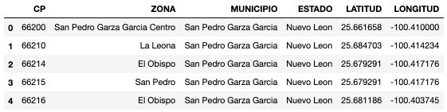
DATA CLEANING
Final dataframe:

Slide 5
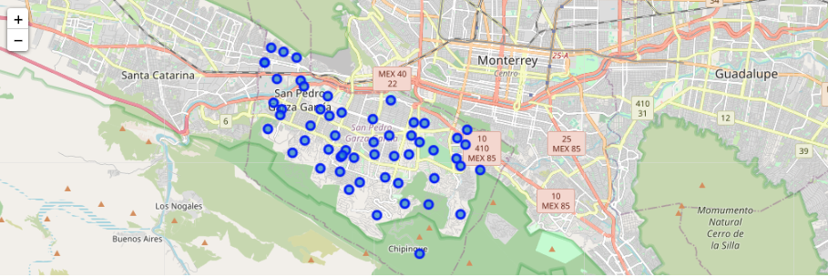
POSTAL CODES LOCATIONS

Slide 6
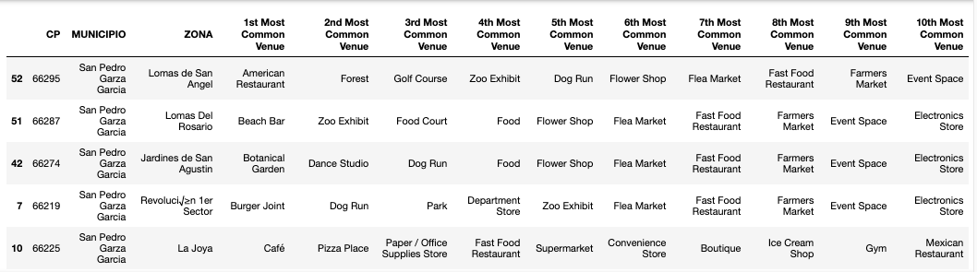
TOP 10 VENUES PER LOCATION

Slide 7
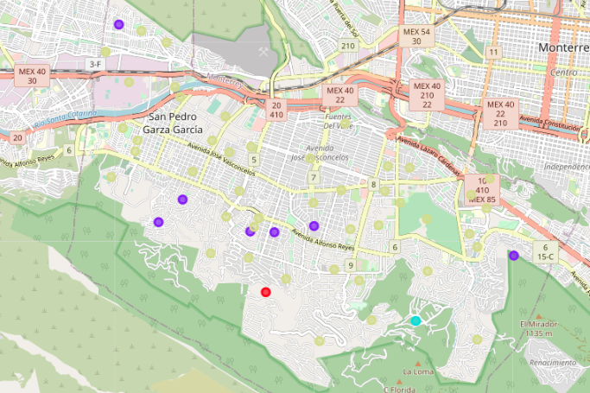
CLUSTERED LOCATIONS
Cluster | Color | Characteristics
0 | Red | This neighborhood principal venues are department stores, zoo and dive bars
1 | Purple | Around these neighborhoods there are a lot of parks, school buildings and recreational places for sports.
2 | Blue | Recreational places, zoo exhibits and diners
3 | Yellow | Burger joints, parks, and department stores.

Slide 8
CONCLUSION
After analyzing the previous information, there is a detail that catched my eye: cluster number one. Cluster number one has really interesting characteristics which I think it makes it suitable to start a restaurant or a juice bar; this cluster main characteristics are that is surrounded by recreational places such as parks, gyms and also school buildings. Having this information plus the uprising trends during the last decade about a healthier life style and taking care of your body, I think that starting a resturant of healthy food, or a smoothie/juice bar or even a different type of gym in this neighborhood is very promising since people who go to this recreational places in the neighborhood would find it convenient to have a healthy restaurant or a smoothie bar where they have a snack or a drink after a long walk in the park. Also you can take into account all the teenagers who go the the schools around this neighborhoods and their parents who will frequent these places and would have to wait frequently for their sons and would prefer to wait in a nice healthy bar or restaurant instead of just being park in their cars.

